Slide 1
Where to settle in Montreal city
A helping decision making study

Slide 2
Contextualization
Quebec is receiving yearly 40 000 new immigrants
70% of them choose to settle in Montreal (approx. 28 000)
One of the biggest new immigrants preoccupations : minimize their spending during their job search on for the first 2-3 months

Slide 3
Purpose of this study
Help the new immigrants, who are planning to settle in Montreal, decide in which borough to settle in, regarding to their budget and the venues of interest present within the borough.

Slide 4
Data acquisition and preprocessing
Average rental cost for the boroughs and related cities of Montreal, scraped from the Montreal city portal :
Montreal boroughs
Montreal agglomeration
Json file presenting Montrealer boroughs delimitation, from the city portal.
Data on venues within the boroughs, collected via Foursquare API.
Final data contains 7 features.

Slide 5
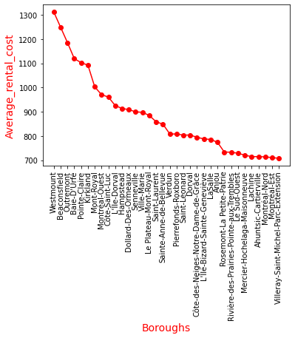
Average rental cost per boroughs
The graphic below shows that the top 5 boroughs with the highest rental cost are :
Westmount
Beaconsfield
Outremont
Baie-D'Urfé
Pointe-Claire

Slide 6
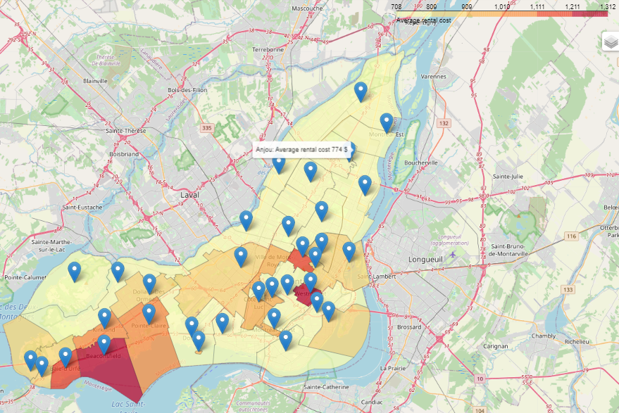
Average rental cost per boroughs
Most of the boroughs have an average rental cost under 950$.

Slide 7
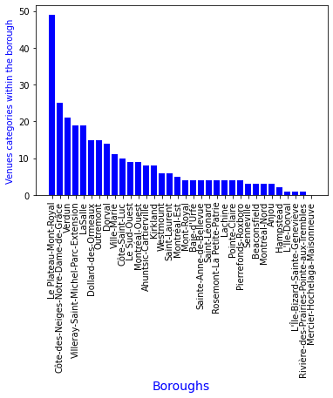
Venues categories count per boroughs
In terms of variety of venues categories, the top 5 boroughs are :
Le Plateau-Mont-Royal
Côte-des-Neiges-Notre-Dame-de-Grâce
Verdun
Villeray-Saint-Michel-Parc-Extension and
LaSalle
These boroughs are exactly the same boroughs with higher numbers of venues, whatever the categories of the venues.

Slide 8
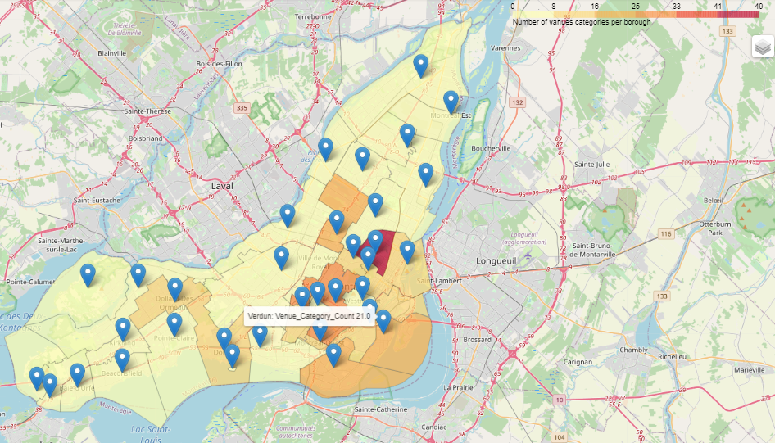
Venues categories count per boroughs
Boroughs with higher number of venues categories are concentrated in the center and the south of the city.

Slide 9
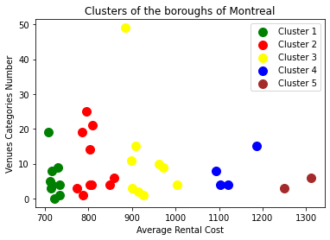
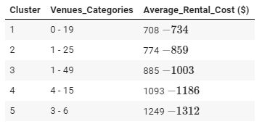
Bringing all information together
Clustering the boroughs based oh their average rental cost and the venues categories within them

Slide 10
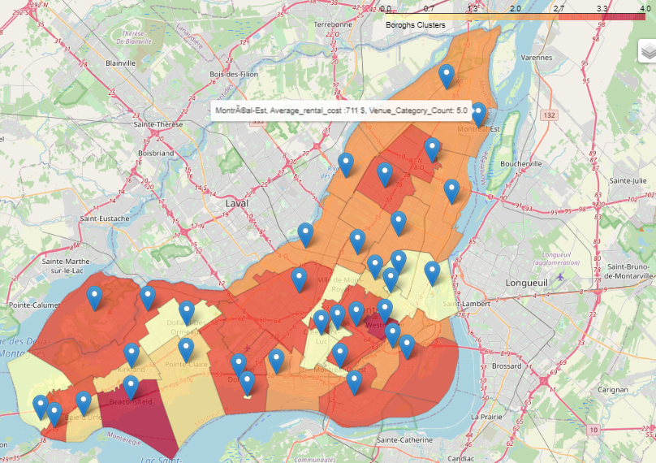
Bringing all information together
Clustering the boroughs based oh their average rental cost and the venues categories within them
Rental cost choropleth map
Venues categories count choropleth map
Unlike the first graphics and taking into account both the information about rental cost and venues, similar boroughs are slightly scattered all over the city.

Slide 11
Conclusion and future directions
Conclusion
We can objectively say that the boroughs located on the periphery of the island still more affordable and having a fair number of venues categories.
Future directions
Ideas include :
More details about the venues.
Rental availability.
Job perspectives per borough (if available).

